Slide 1
Component-Oriented Design and Architecture
Dan Trong Thai

Slide 2
Why are Component Models used?
Tight Coupling
Measuring the Coupling of a system (DesignLab)
Our aim is to have low coupling and high cohesion
How can these issues be avoided?

Slide 3
Common Modules and Interfaces
Common Modules
Offers Common Business Entities
Create separate modules
Interfaces
Expose functionalities through interfaces

Slide 4
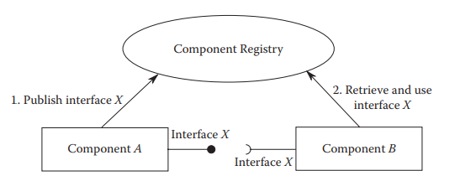
Whiteboard Model

Slide 5
Dependency Injection
Inversion of Control
Classes depend on abstraction
Objects define their dependencies without creating them
The Framework creates the object instead

Slide 6

SpringLab
XML-based configuration
Define Beans
Spring Container
Represented as the ApplicationContext
Multiple instances, each with its own configuration.
Access Beans

